Slide 1

Euro Dollar Future Trading Strategy
Pham Tuan Phong
PhD in Finance – La Trobe University

Slide 2
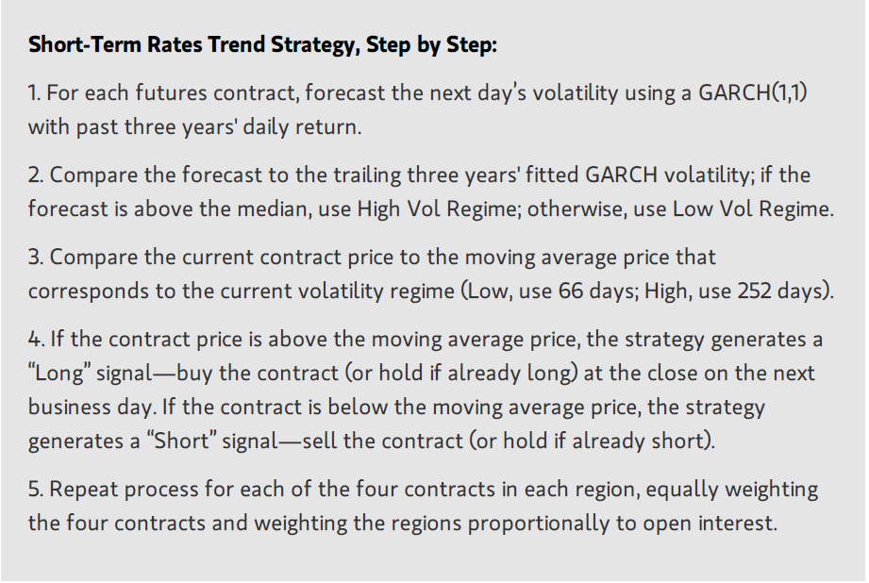
Summary of Strategy

Slide 3
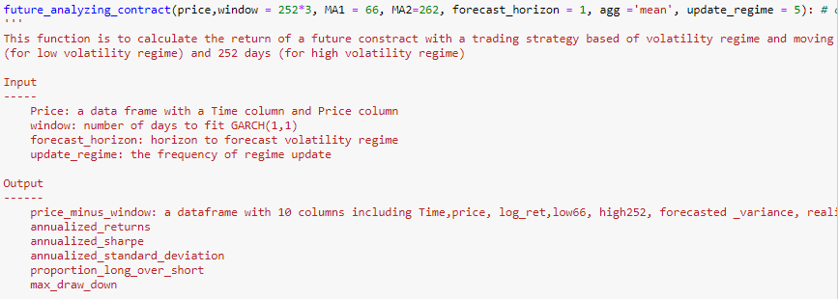
Main functions
future_analyzing_contract:

Slide 4
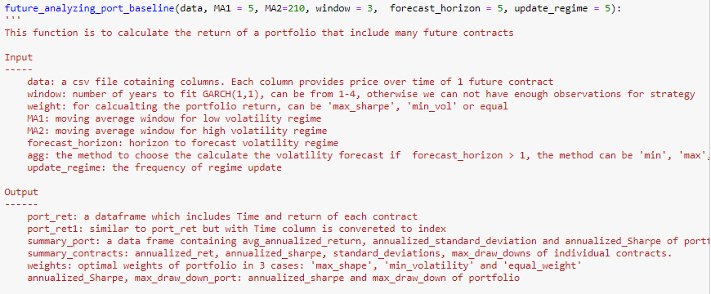
Main functions
future_analyzing_port_baseline:

Slide 5
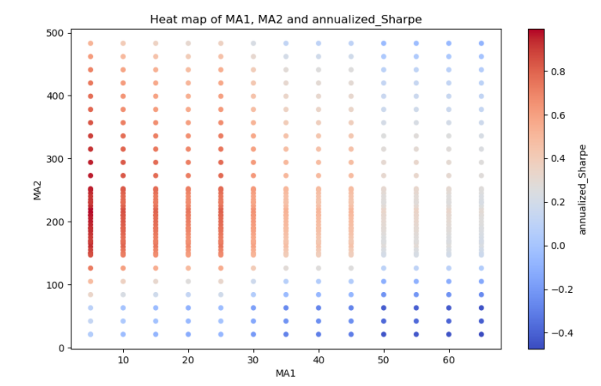
1. run grid-search with changes of MA1 ( fast-moving window) and MA2 (slow-moving window) to see how these parameters affect the Sharpe ratio
Notes:
Remember to talk about P-value

Slide 6
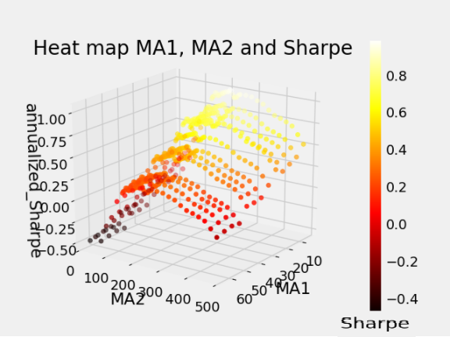
For easier to imagination, I created a 3d heat map
It can be seen that MA1 = 5 days and MA2 moves in a range from 200 - 300 days tends to produce highest Sharpe ratio
Notes:
Remember to talk about P-value

Slide 7
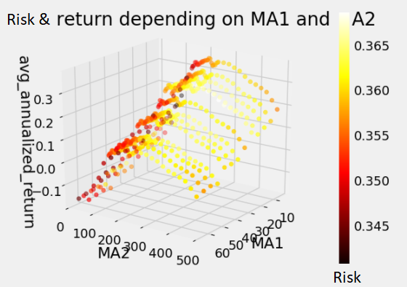
2. How changes in MA1 and MA2 affect risk and return profile?
Notes:
Remember to talk about P-value

Slide 8
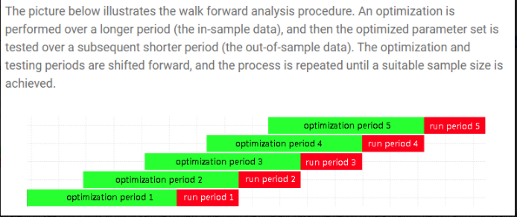
3. To avoid overfitting, I run Walk Forward Analysis to see how the strategy works in out_of_sample context. - The Walk Forward Analysis can be described as follows:
Notes:
Remember to talk about P-value

Slide 9
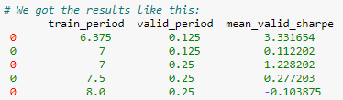
- To run Walk Forward Analysis, first I run a for loop to find an optimal training window and testing out-of-sample window - From the above results I choose 1606 days (6.375*252) for training period from that we got optimal MA1 and MA2 & then apply these MA1, MA2 into testing period of 31 days (0.125*252). The the out-of-sample results over the 4 years (2015-2019) are as follows:
Notes:
Remember to talk about P-value

Slide 10
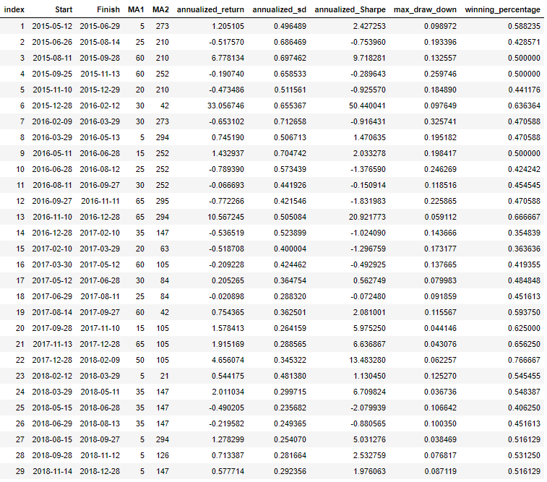
Notes:
Remember to talk about P-value

Slide 11
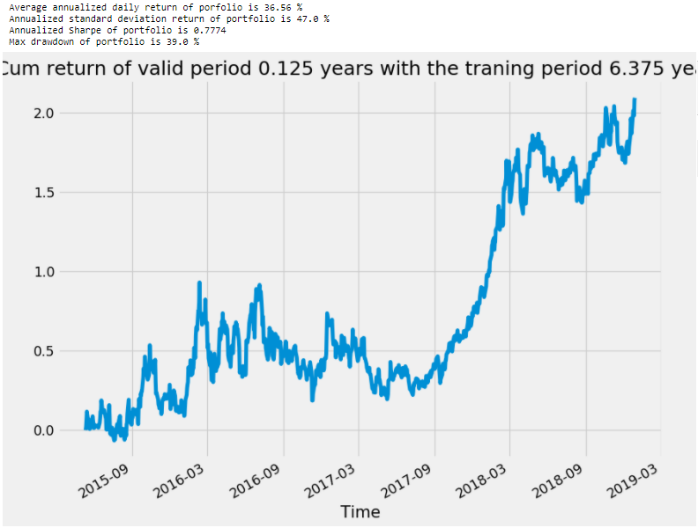
4. After the above analysis, I concatenated returns of small periods and check the performance of the whole out-of-sample testing period. The results are as follows:
Notes:
Building Strategy:
The model represents a mathematical specication of the
trading strategy. There are two important considerations in
this specication: the selection of which factors and how
these factors are combined. Both considerations need to be
motivated by the economic intuition behind the trading
strategy.
Evaluating, Backtesting, and Implementing the Strategy:
The nal step involves assessing the estimation, specication,
and forecasting quality of the model. This analysis includes
examining the goodness of t (often done in sample),
forecasting ability (often done out of sample), and sensitivity
and risk characteristics of the model.

Slide 12
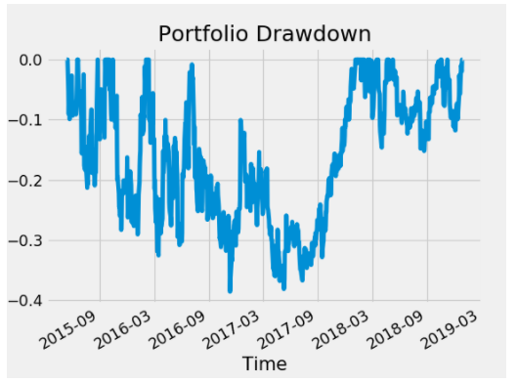

Stage 4: Factor combination
2. Solutions:
For combining factors, we rescale factors while preserving their order using standardization process. Typically, we choose the standardized variable to have a mean of zero and a standard deviation of one and eliminate outlier observations (winsorizing).
${zscore}_{i}=\frac{x_{i} − \overline{x}}{σ_{x}}$
For correlated factors, we calculated correlation matrix ($ρ$) for all selected factor and adjusted the IC of factors taking account to the correlation matrix. In order to that, we used the following formula of Grinold & Kahn (2000):
$$IC^{′}= {IC}^{T}∗ρ^{−1}$$
Eliminate the factors with t-stat < 2 and IC’ <1%
For weighting factor, we weight them based on the proportion of adjusted IC over the
Notes:
Add Winsorizing

Slide 13

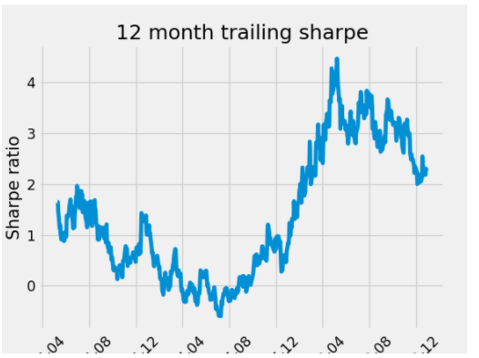
Out of sample performance summary

